Slide 1
42nd Annual Meeting of the
Society for Descriptive Psychology
October 4, 2020
My Dissertation Journey with Peter Ossorio: A Personal and Conceptual Story

Slide 2
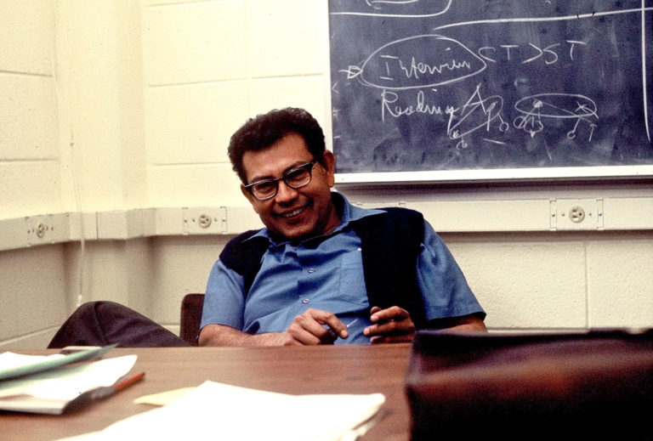
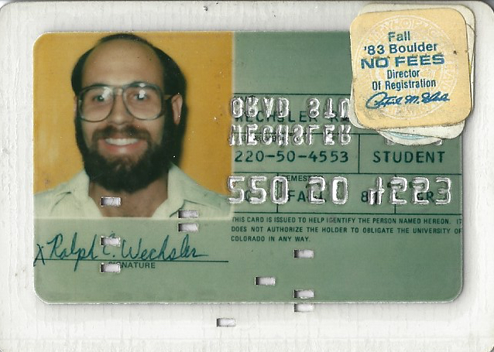
Doctoral Supervision
1981-1983

Slide 3


Meetings with Pete: Whenever and wherever….

Slide 4
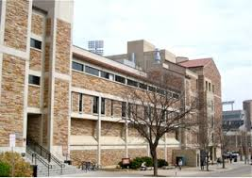
Muenzinger Psychology Building
University of Colorado at Boulder

Slide 5

Dissertations, and Theses from Start to Finish: Psychology and Related Fields

Slide 6
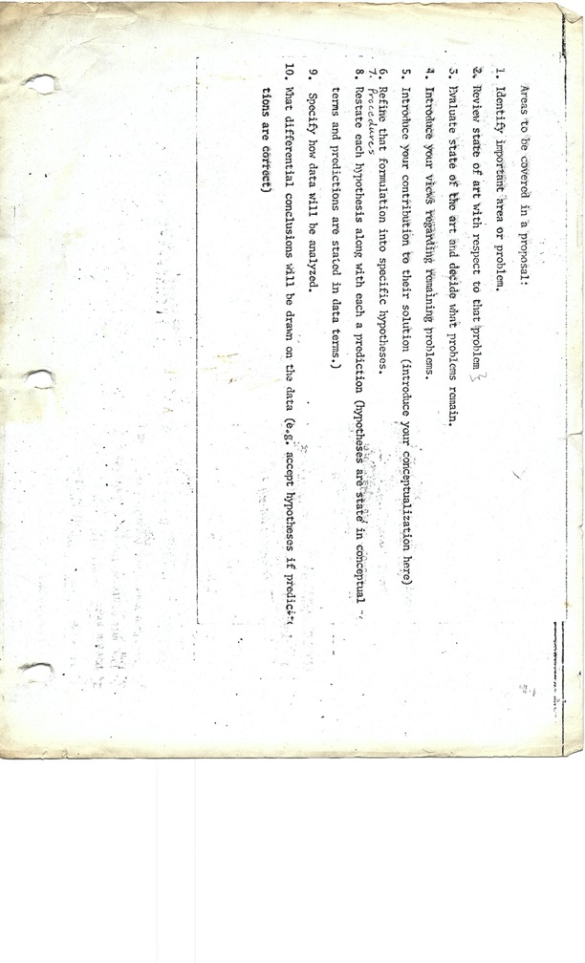
Pete’s Proposal Outline

Slide 7
    Areas to be covered in a proposal:
  Identify important area or problem.
  Review state of art with respect to that problem.
  Evaluate state of the art and decide what problems remain.
  Introduce your views regarding remaining problems.
  Introduce your contribution to their solution (introduce your conceptualization here)
  Refine that formulation in to specific hypotheses.
  Procedures.
  Restate each hypothesis along with each a prediction (hypotheses are stated in conceptual terms and predictions are stated in data terms).
  Specify how data will be analyzed.
  What differential conclusions will be drawn on the data (e.g., accept hypotheses if predictions are correct).

Slide 8
THE HYPOTHESES
      H1: Manics will be less inclined to imagine a loss of status (i.e., a degradation) occurring.
      H2: Manics will be more reactive to changes in status (i.e., degradation and/or accreditation).
      Manics will prefer the Being aspects of status over the Doing aspects of statuses.
      H4: Manics will be more reactive to a lowered status (i.e., a degraded one).
      H5: Manics will be less inclined to claim a degraded status and/or more inclined to claim an accredited status.

Slide 9
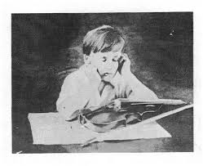
THEMATIC APPERCEPTION TEST
Story One

Slide 10


Manic “Being” versus Manic “Doing”

Slide 11
HYPOTHESIS 3
    Given that a loss of status is unthinkable, a manic will try to avoid such a loss by attempting to “be” someone with more status. These self-affirmations consist primarily of having a certain status, or, in other words, of being someone with particular tastes, values, aspirations, etc. Only secondarily is the manic interested in doing what it would take actually to validate that status. For the manic, the membership aspects of a status count for more than do the performance aspects. Therefore,
      Manics will prefer the Being aspects of status over the Doing aspects of statuses more than normal.

Slide 12

Police Officer
        Being-wearing a police officer’s uniform
        Doing-writing a test report
        Neutral-attending roll-call at the beginning of the shift
        Doing-directing traffic at an intersection
        Being-having a cup of coffee with another officer at a diner

Slide 13

College Professor
        Doing-giving a lecture to a class
        Being-serving on a university faculty committee that issues parking permits
        Neutral-reading a newly published article in your field
        Being-belonging to the faculty club
        Doing-preparing an outline for a course

Slide 14

Banker
        Being-belonging to the Chamber of Commerce
        Doing-reviewing the bank’s balance sheets for the month
        Neutral-opening the bank in the morning
        Doing-financial planning with the bank’s accountant
        Being-having free access to the bank’s vault

Slide 15
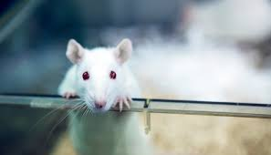
The Challenges of Quantitative Analysis

Slide 16
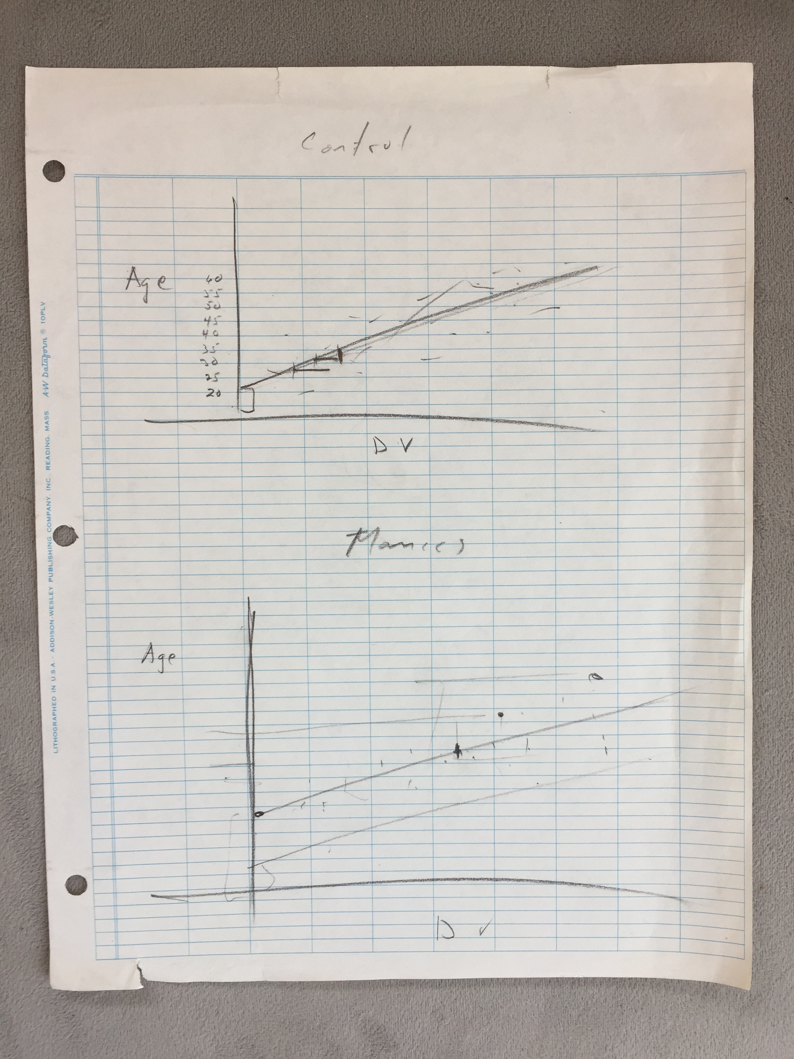
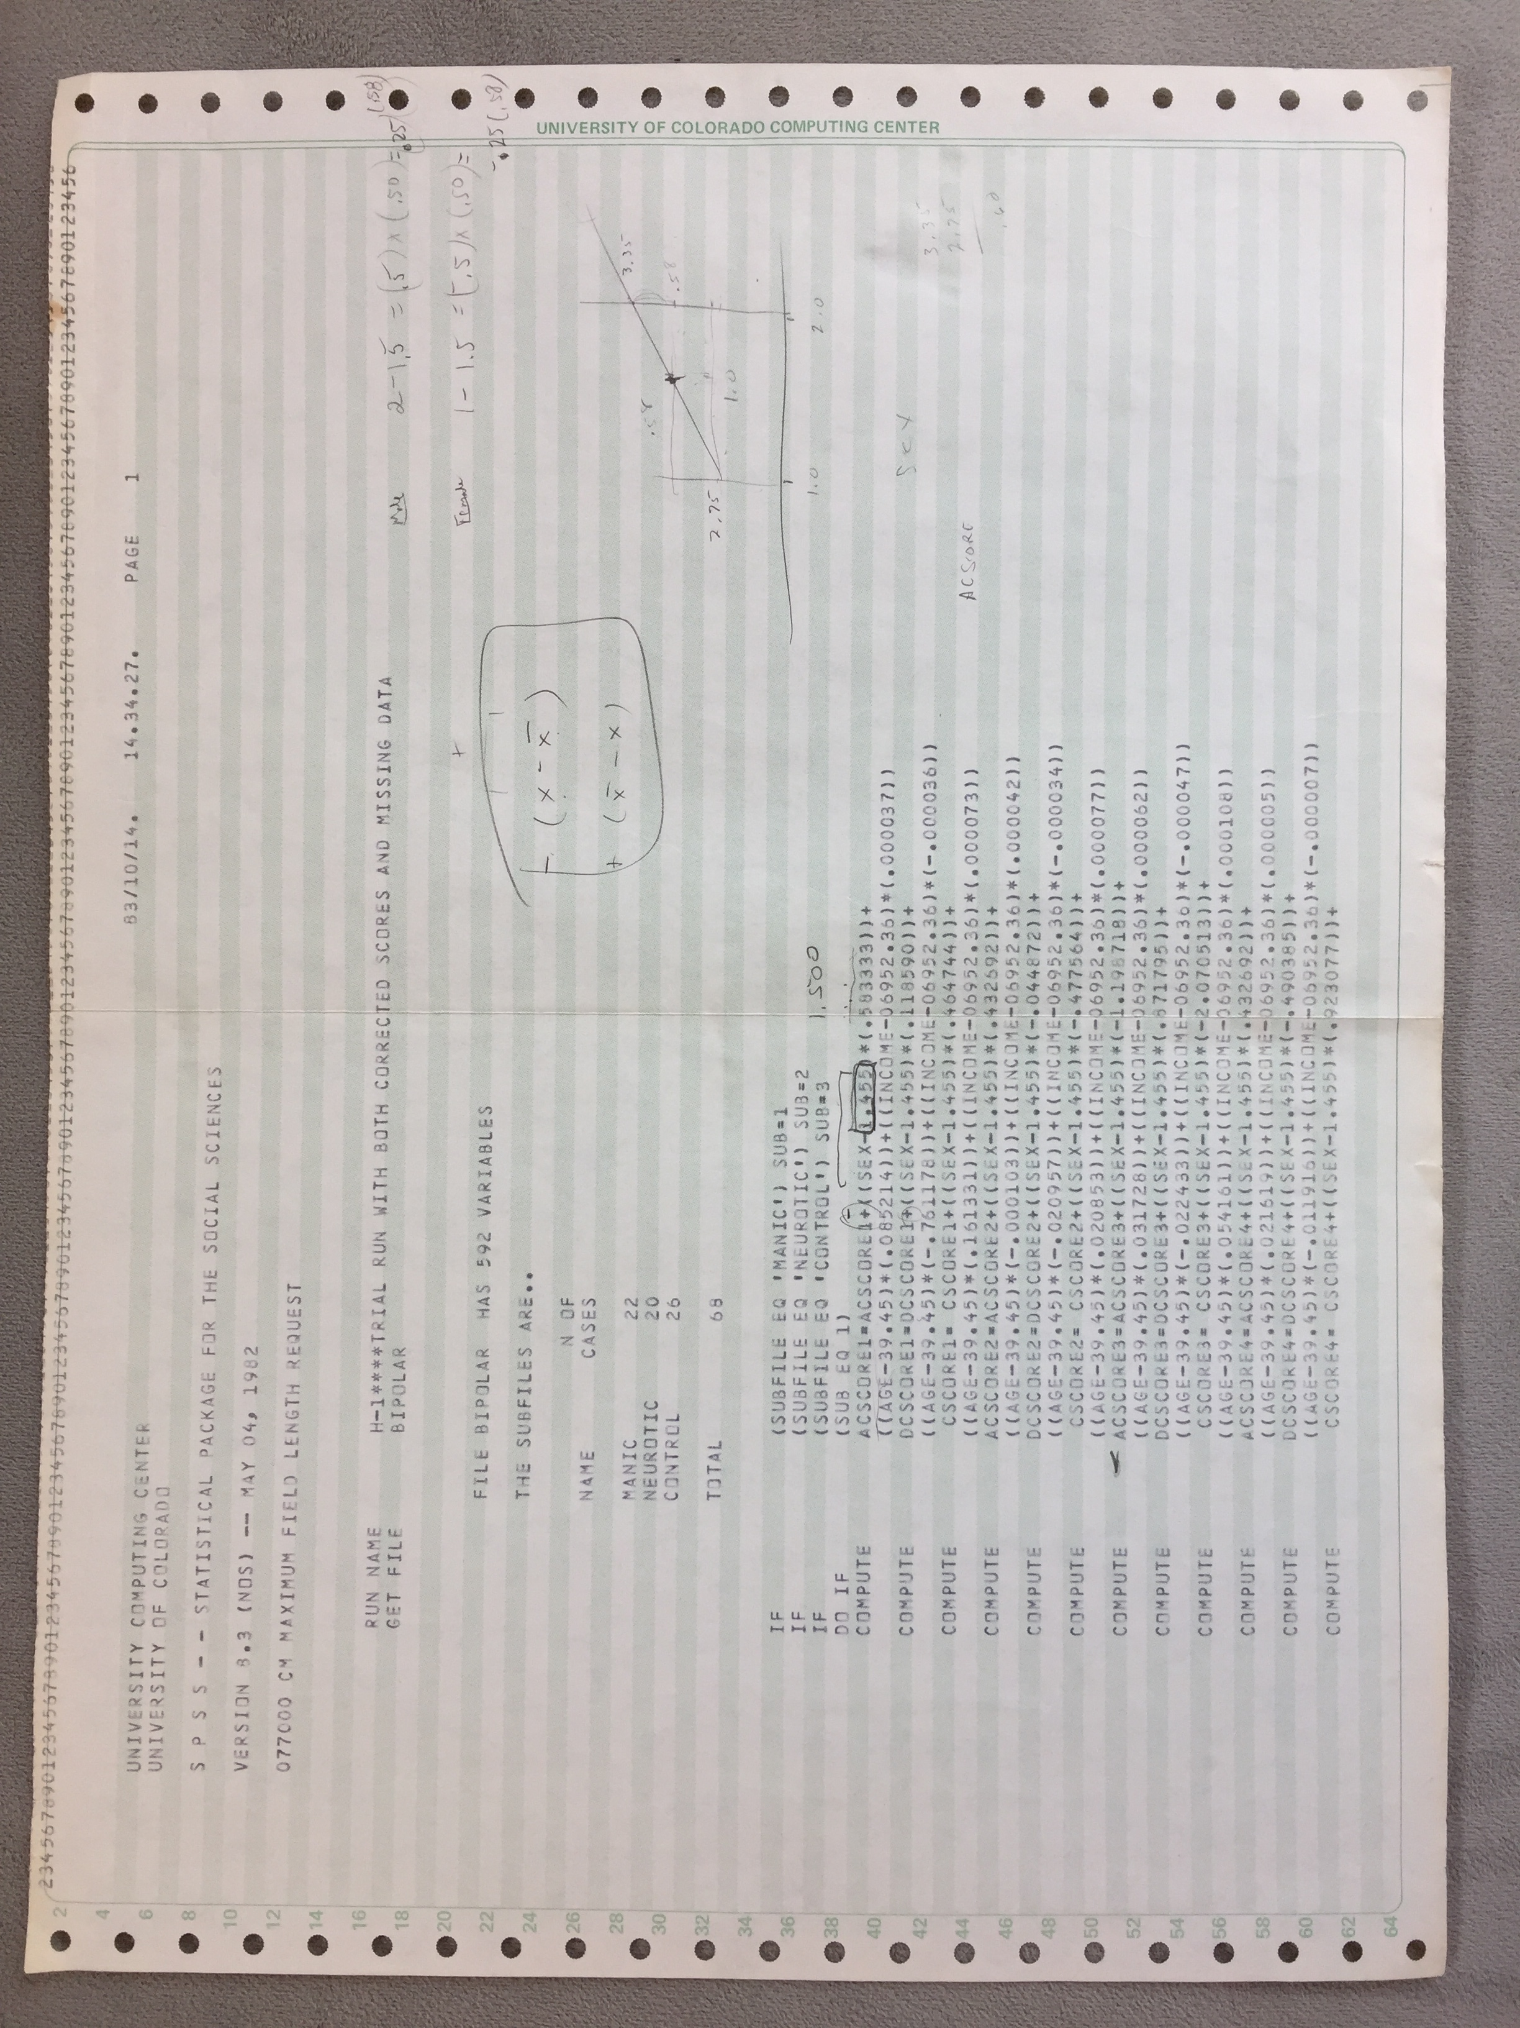
Pete helping me wrap my head around the data analysis

Slide 17
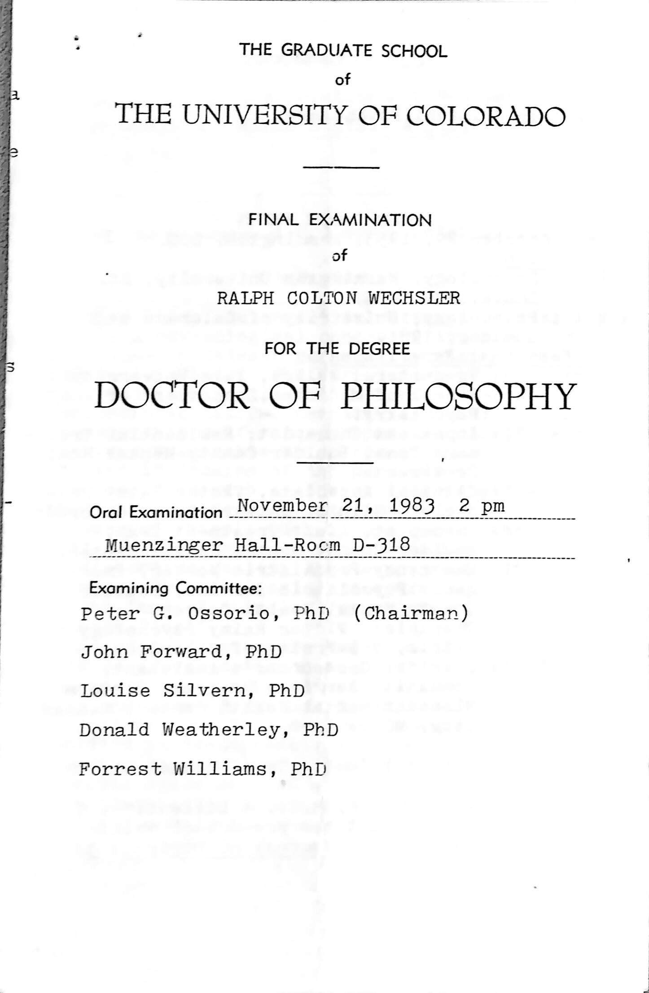
The Final Orals
November 21, 1983

Slide 18
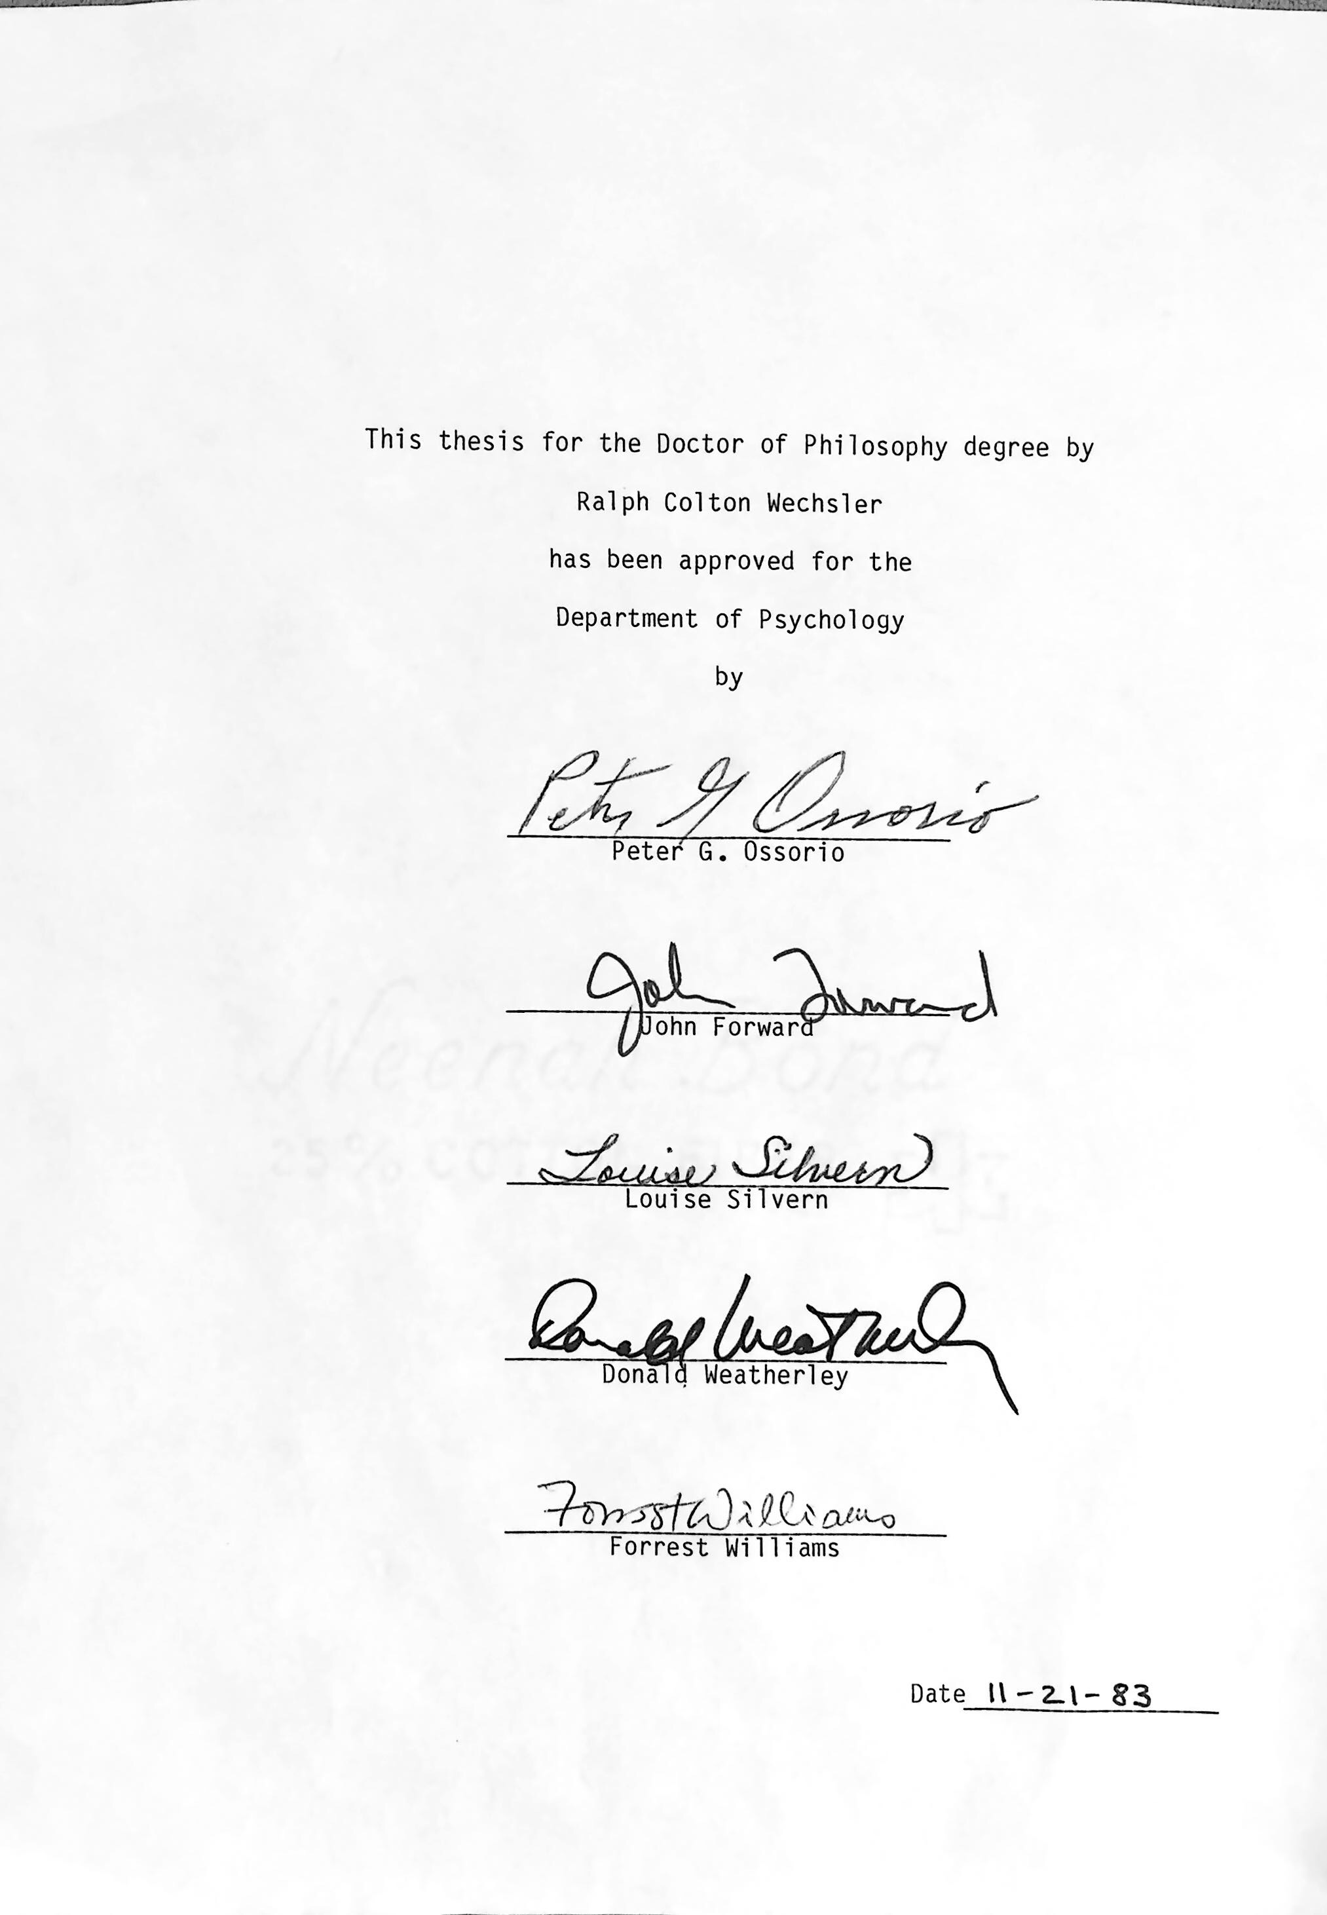
Passed!

Slide 19
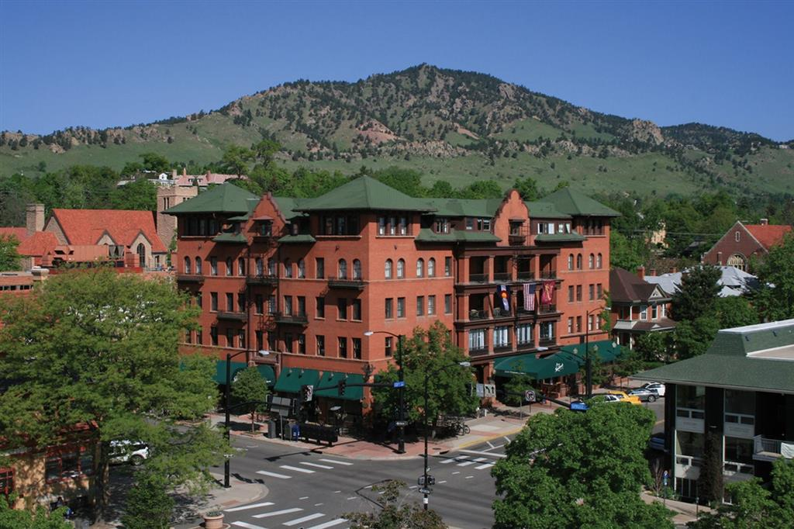

HOTEL BOULDERADO

Slide 20
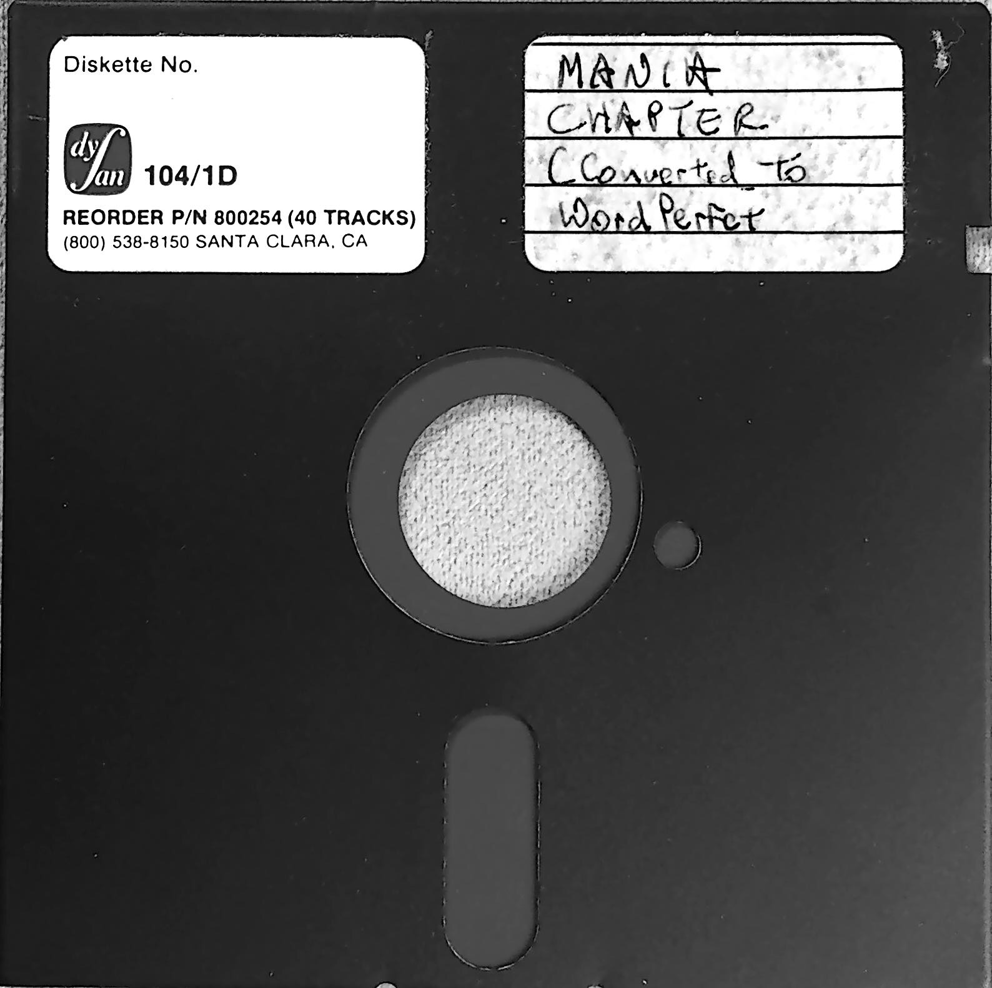
The Dissertation

Slide 21

The Finished Product…All 5 Pounds and 11 Ounces of it.

